Slide 1
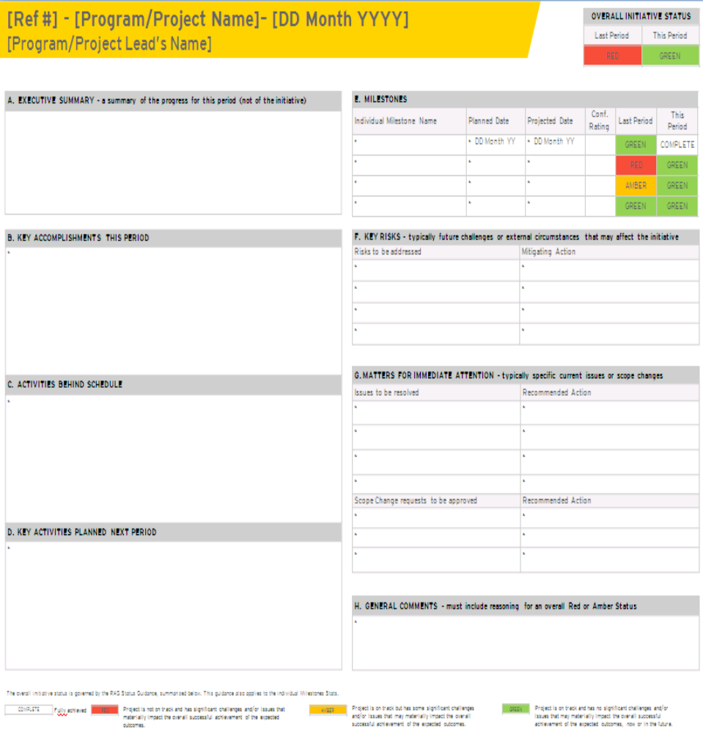
Status report guidance
April, 2012
Update the overall RAG status from the previous reporting period and add the RAG status for this reporting period:
Red - Project is not on track and has significant challenges and/or issues that materially impact the overall successful achievement of the expected outcomes.
Amber – Project is on track but has some significant challenges and/or issues that may materially impact the overall successful achievement of the expected outcomes.
Green – Project is on track and has no significant challenges and/or issues that may materially impact the overall successful achievement of the expected outcomes, now or in the future.
5
Summary of progress made since last reporting period
This should not refer to the description or objectives of the initiative.
1
6
List key milestones, planned and projected dates. Include RAG status for each milestone.
Confidence Level Rating only applicable for Enterprise Programs.
Milestones should include any critical program / project-specific milestones plus current and next phase tracking milestones.
Briefly state key accomplishments. For example, what key risks/issues have been resolved? What ccritical elements have gone from Red to Amber or Green?
This should not be an exhaustive list of tasks performed during the reporting period.
2
7
Report only key/critical risks and mitigating actions, particularly those risks that may have significant impact, such as on other programs.
List key / critical activities behind schedule, the impact, and what is currently being done to bring it back on schedule. This should include “warnings” of any pending impact that leadership and/or other programs should be aware of.
8
Report only key/critical issues and action being taken to resolve; includes issues that require escalation—i.e. immediate attention and assistance by leadership for resolution.
3
9
List pending change requests to be approved and recommended actions.
List key / critical activities planned in the next 2 weeks.
This should not be an exhaustive list of tasks to be performed.
4
Explain reason for program/project and/or key milestones reporting Red or Amber status. Specify:
Why red/amber?
What is significance? What is the impact?
What mitigating actions are in place and when are they planned?
10

